Slide 1
Final Design Review
Team Laser pong
Dominic Benintendi, Ian Gant, Aditya Sahi, Andrew Edmonds

Slide 2
Introduction

Slide 3
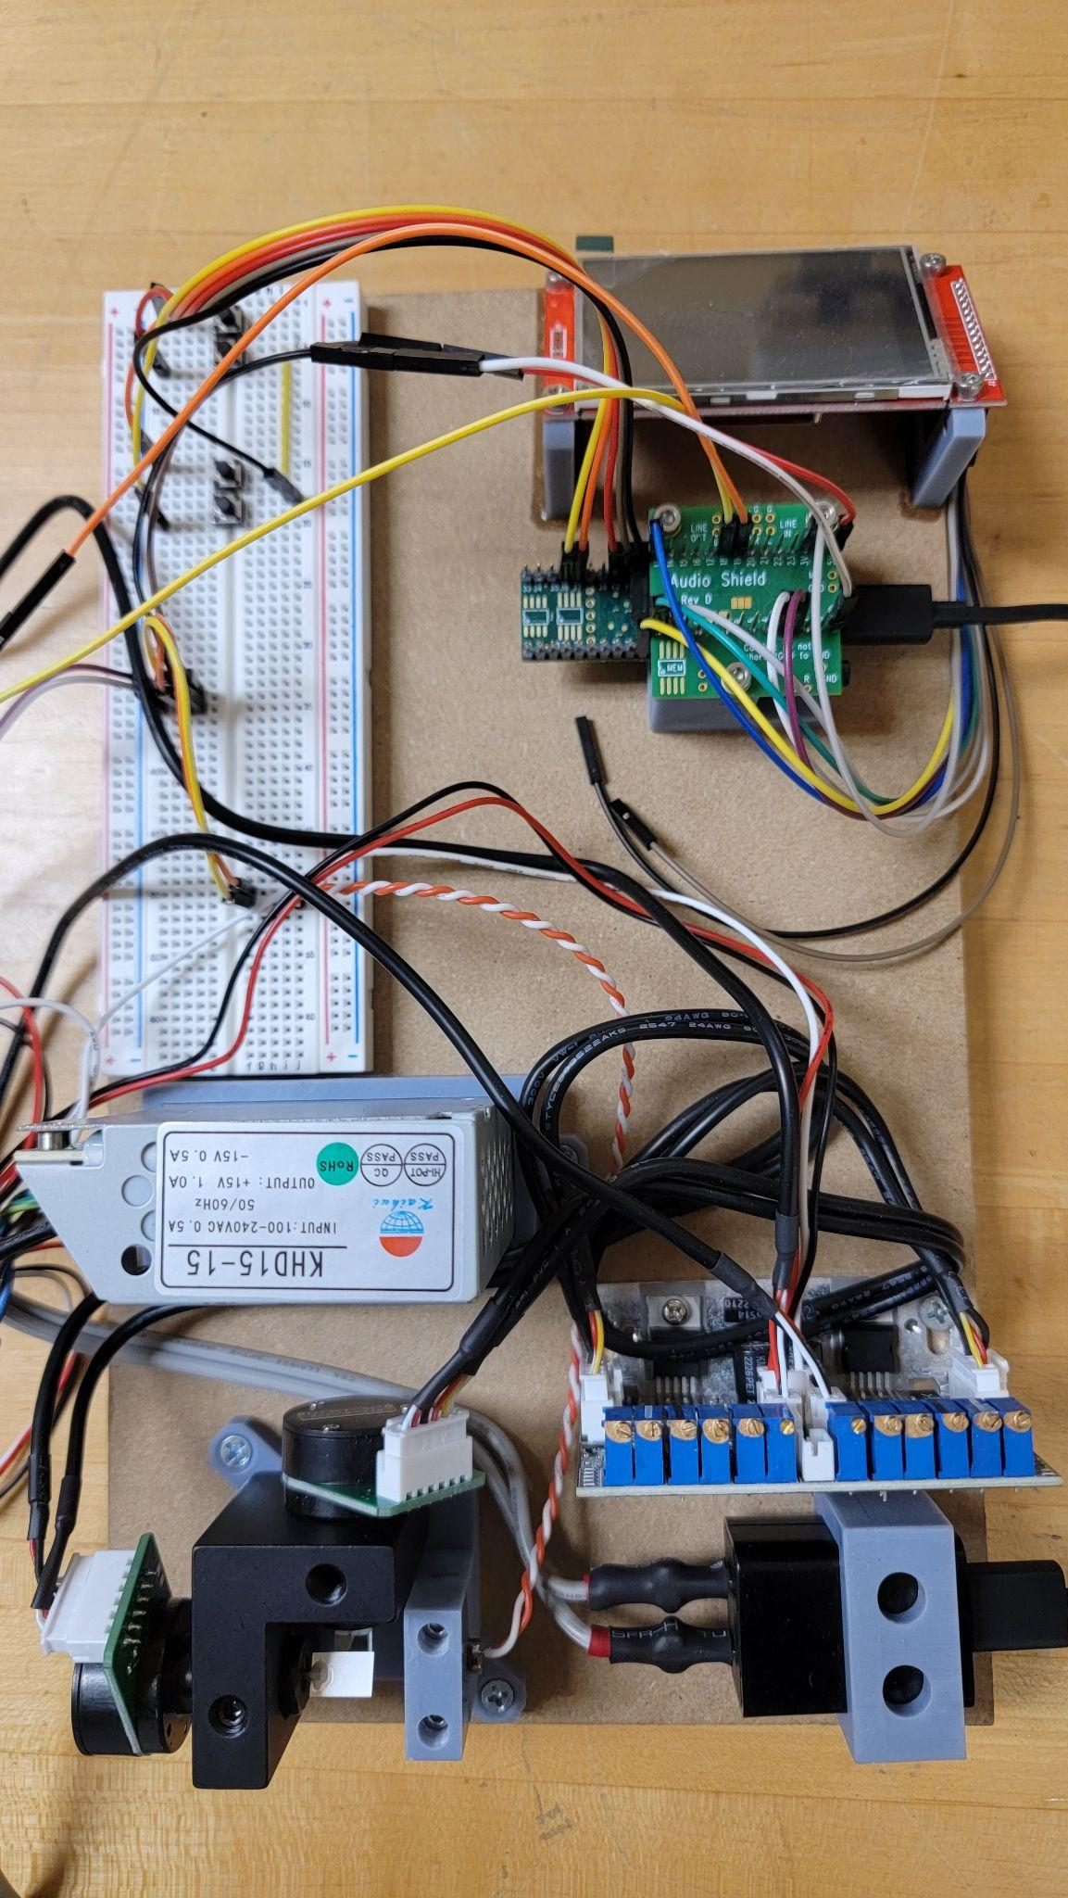
Project Summary
We are the Laser Light Show Team.
Our goal was to make a laser console that can project shapes, images, animations and most importantly… Pong

Slide 4
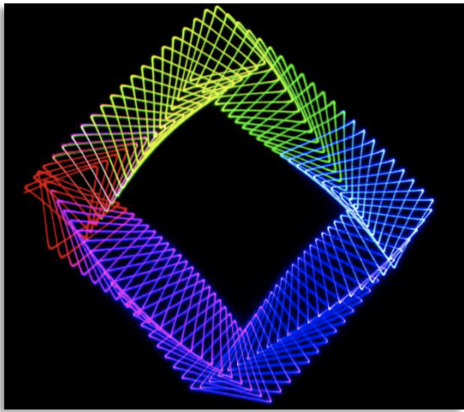
Customer Needs
A laser light show projector that can project images, shapes, animations as well as the classic game pong.
An intuitive UI to navigate and control the device
Controllers that allow for an ample range of control, with negligible delay.

Slide 5
Needs / Scope
Goals
Implement the game pong
Control pong using two controllers
Display the game of pong using a laser
Objectives
Create a formalized plan for the laser light show design along with listing its constraints, requirements and deliverables.
Create a design and implement a plan for the project.
Establish a design in hardware, along with identifying a safe laser to use in given conditions.
Analyze the design of the project and fix any problems that arise.
Constraints
Cost
Latency of controllers under 10ms
Complete by the expo
Deliverables
Main unit
Comprehensive design report
Operation manual
Live Demo

Slide 6
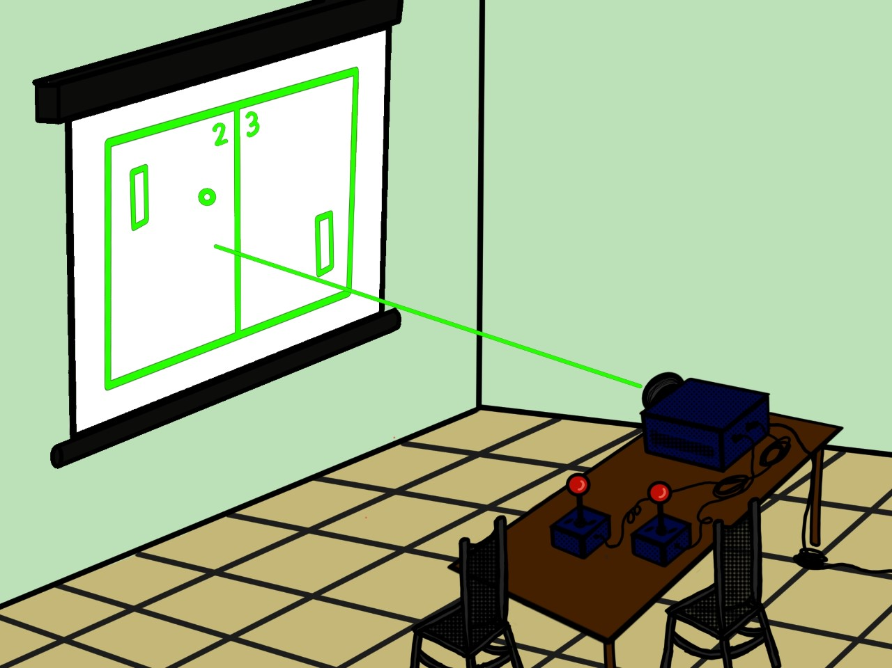
ConOp
Idea
The laser light show project will project the game of pong on a surface using a laser beam. Users will control the game using a set of controllers.
Gameplay
Two paddles on each side of the screen, the ball will be contained within this box.
Projection
Projection of the game is by means of a laser. The device will manipulate a laser beam in a manner quick enough to fool the human eye. This allows the device to create drawings or animations using the moving beam.

Slide 7
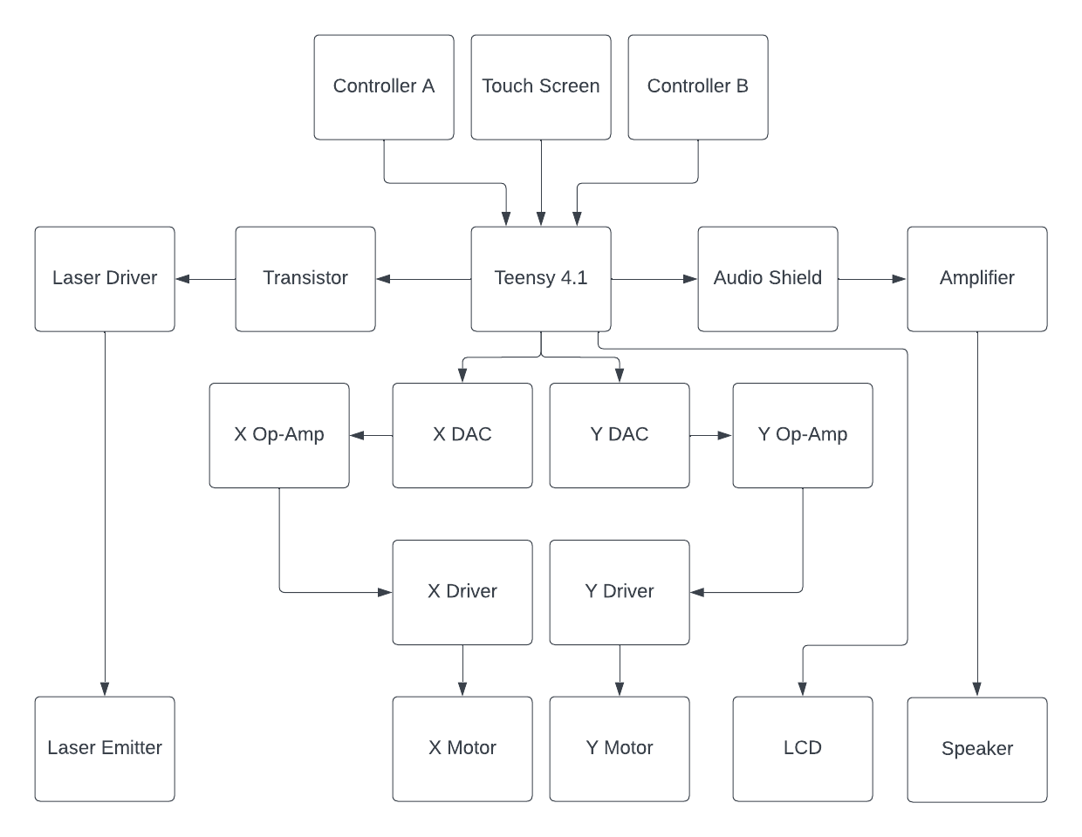
High Level Design Requirements (Hardware)

Slide 8
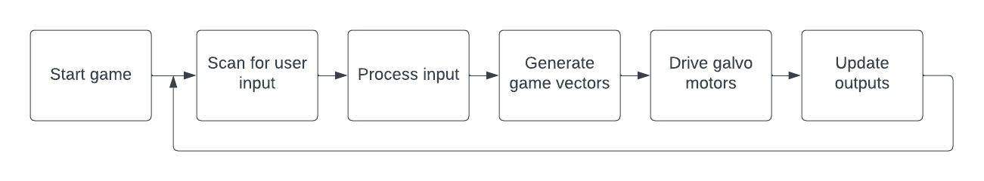
High Level Design Requirements (Software)

Slide 9
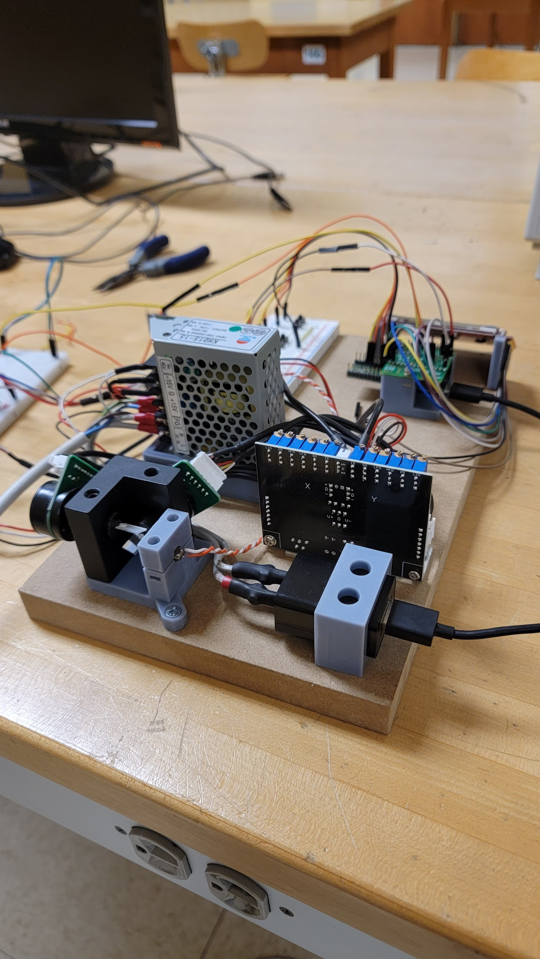
Technical Approach
Subassemblies
Galvos Motors and Drivers
DAC / DAC signal processing
Teensy 4.1 ( Microcontroller)
Touch Screen (800x480)
RA8875 Driver Board for 40-pin TFT Touch Displays
General Purpose Controllers
Three 5mW lasers (red,green and blue)
Audio Drivers
Internal Power Supply

Slide 10
Final Design

Slide 11
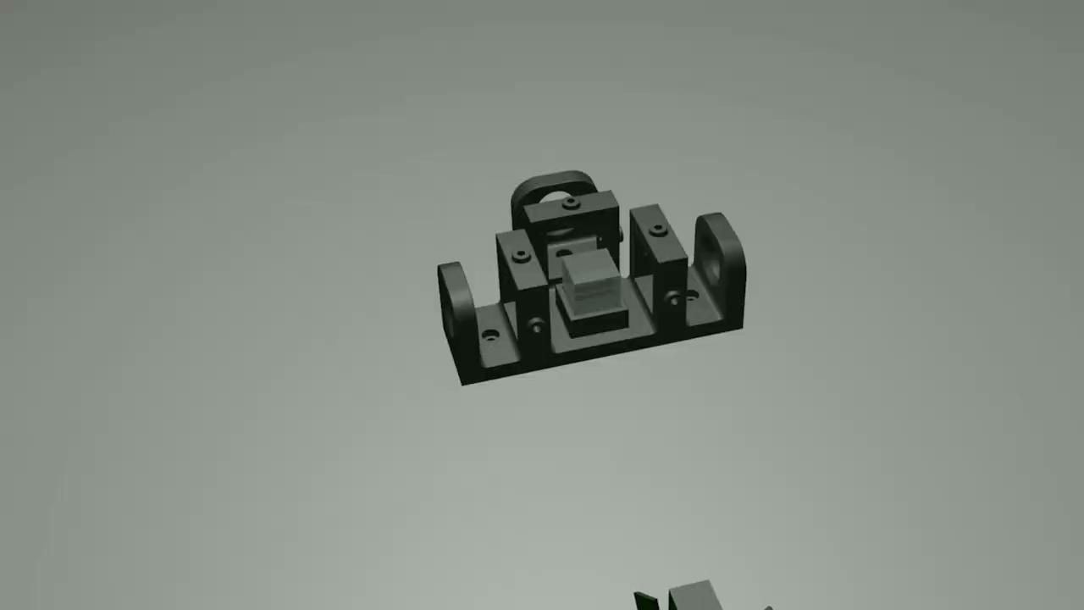

Slide 12
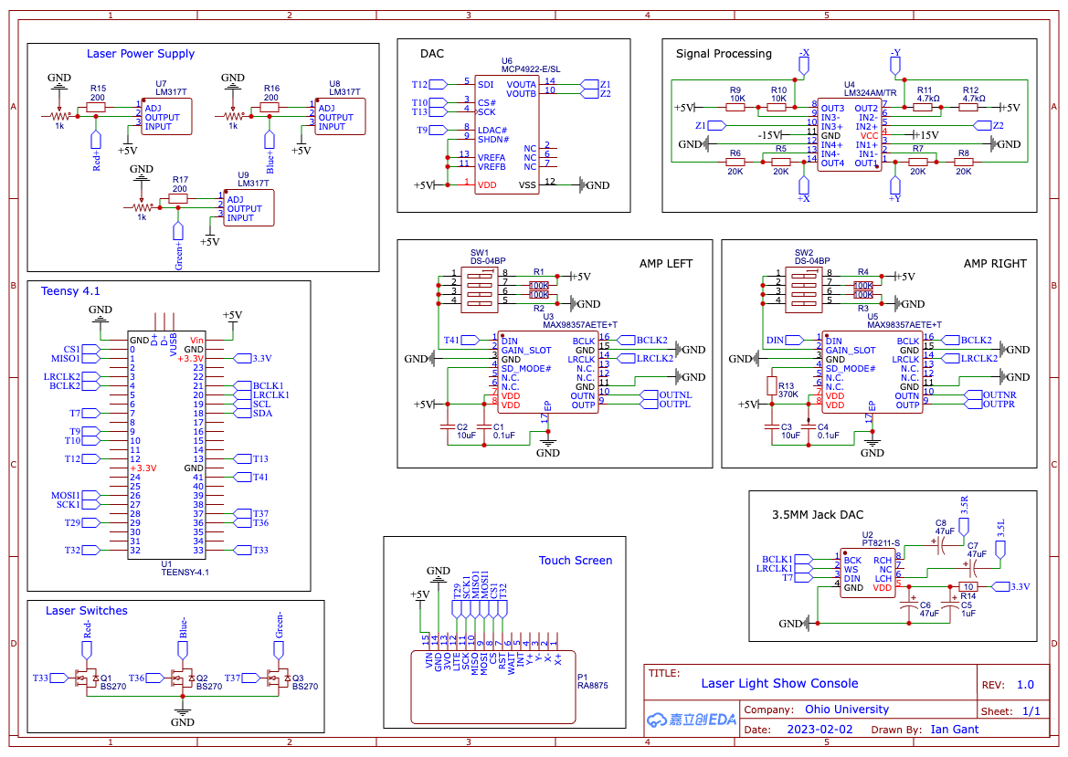
Hardware

Slide 13
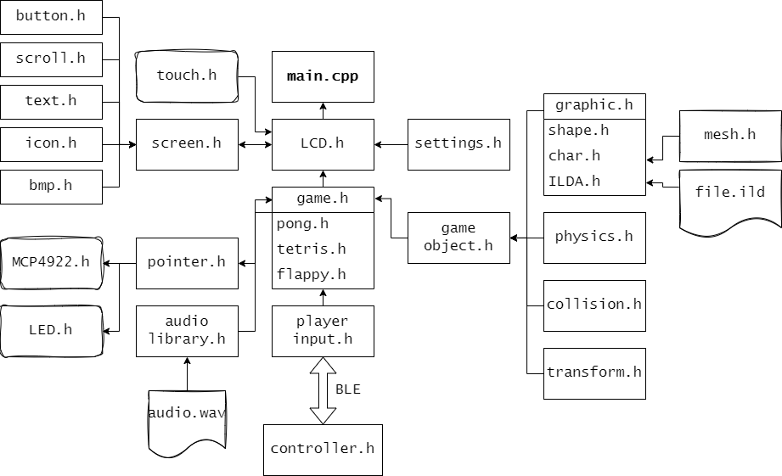
Software

Slide 14
Utilization of Engineering Standards for Design and Implementation
IEC 61508 Functional Safety Standard - sets requirements for electrical, electronic, and programmable electronic (E/E/PE) safety systems to meet specific safety integrity levels.
IEC 61140 Protection Against Electric Shock - specifies protective measures and coordination of the measures within an installation.
EC 60529 Protection by Enclosures - developed to rate and grade the resistance of enclosures of electric and electronic devices against the intrusion of dust and liquids.
IEC 62680 - Defines the connectors, cables, and communications protocols used in a bus for connection and communication between computers and electronic devices.
ISO/IEC 14882:201 - General purpose programming language that was standardized, ratified and published by ISO in 2011.
The IEEE Standard 802.15.4 - allows one to play video games with wireless controllers.

Slide 15
Major Design Tradeoffs

Slide 16
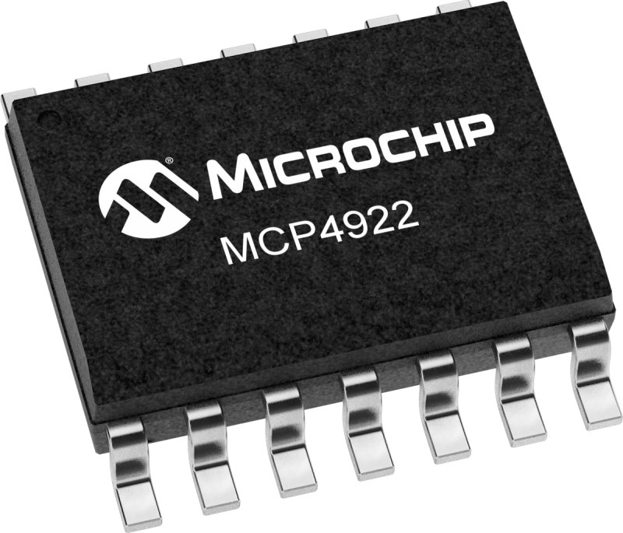
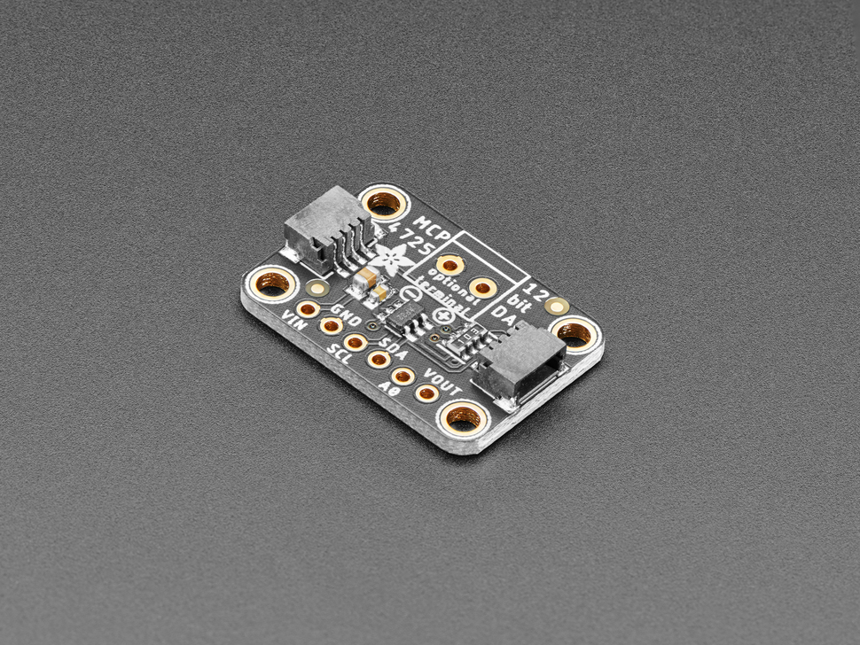
DAC: Trade Study
MCP4922
Uses the SPI Standard
Dual Channel
SMT format
Max 20 MHz Clock Rate
Instruction Buffer for synchronous execution
MCP4725
Uses the I2C Standard
Single Channel
Break-out board format
Max 1 MHz Clock rate
No buffer

Slide 17
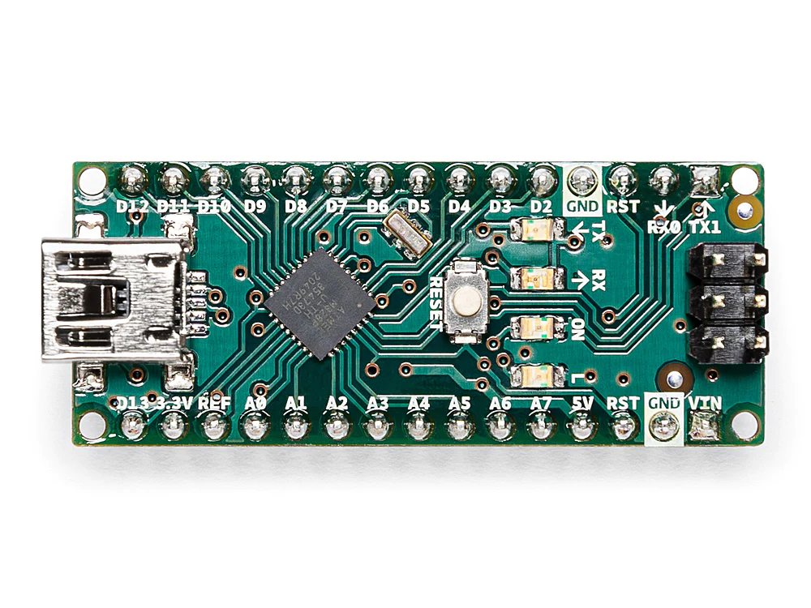
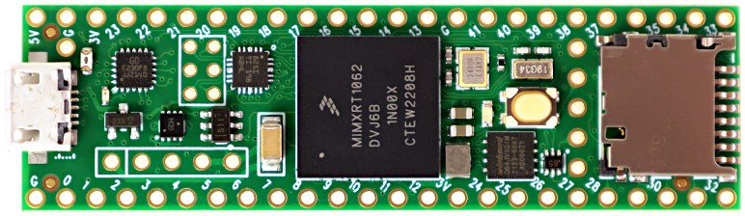
Microcontroller: Trade Study
Teensy 4.1
600 MHz clock speed
55 digital i/o pins
18 analog pins
Micro SD card
Ethernet
Cost: $31.90
Arduino Nano
16 MHz clock speed
22 digital i/o pins
8 analog pins
Cost: $24.90

Slide 18
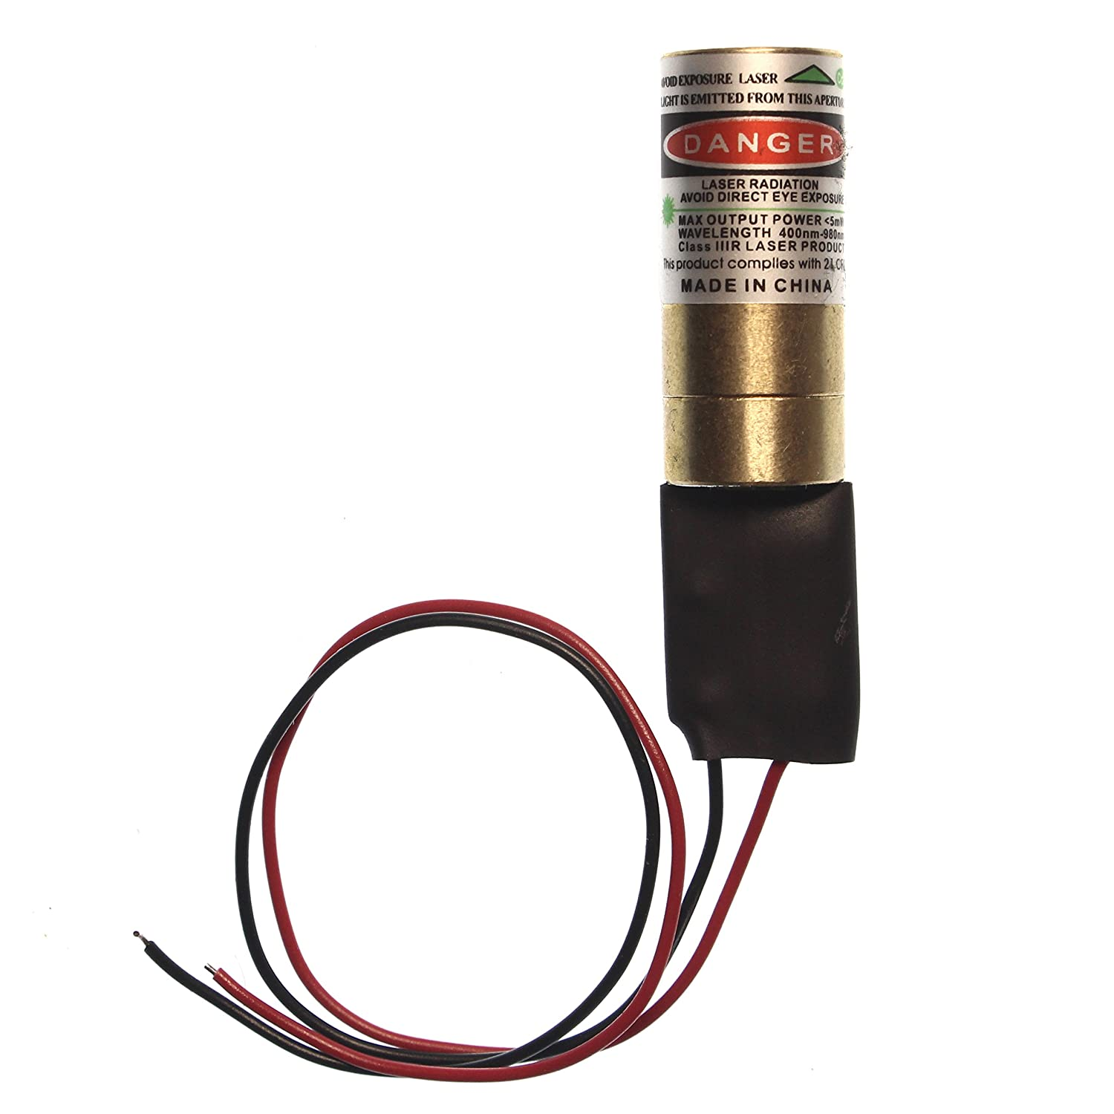
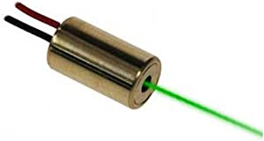
Laser: Trade Study
Class ii
<1mW
520 nm wavelength
No heatsink needed
Class iiiR
<5mW
532 nm wavelength
Heatsink Needed

Slide 19
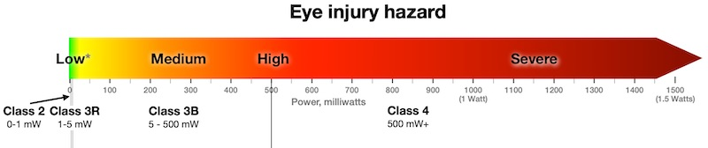
Public Impact
The lasers are class 3R lasers that are < 4.99 mW which comes with caution to avoid direct eye exposure
The lasers are safe to use and voltage regulators were added to control the intensity of each laser.

Slide 20
Verification of Requirements
Software
Create basic prototype module
Run code on unit and see output
Compare to expected output and make changes
When module is complete, reform and clean up code.
Example
Letters like R, with diagonal portions, were being printed with curves
Hardware
Create a basic prototype
Interface new hardware portion with working code.
Look for unexpected results
Make changes to hardware based on results

Slide 21
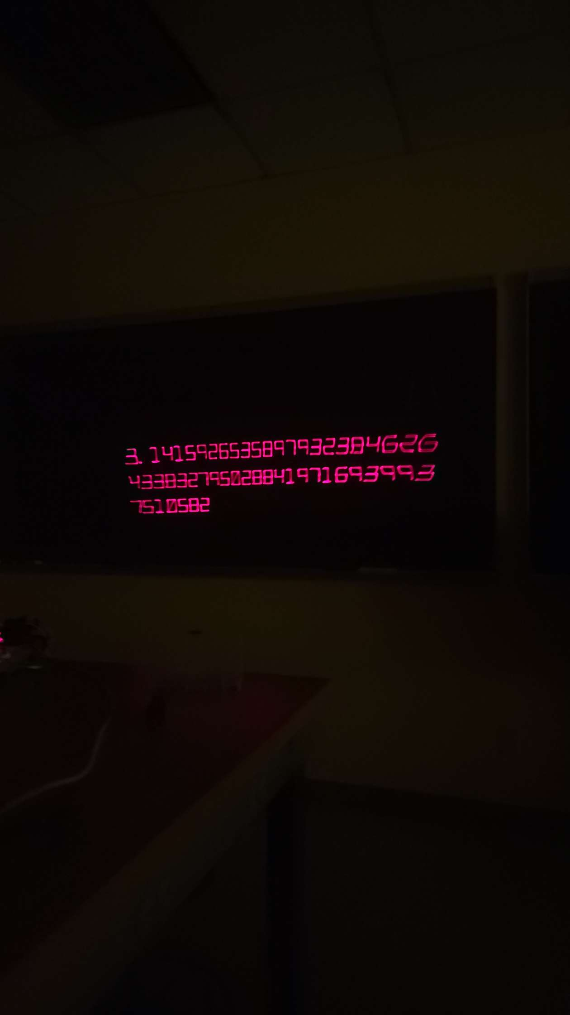
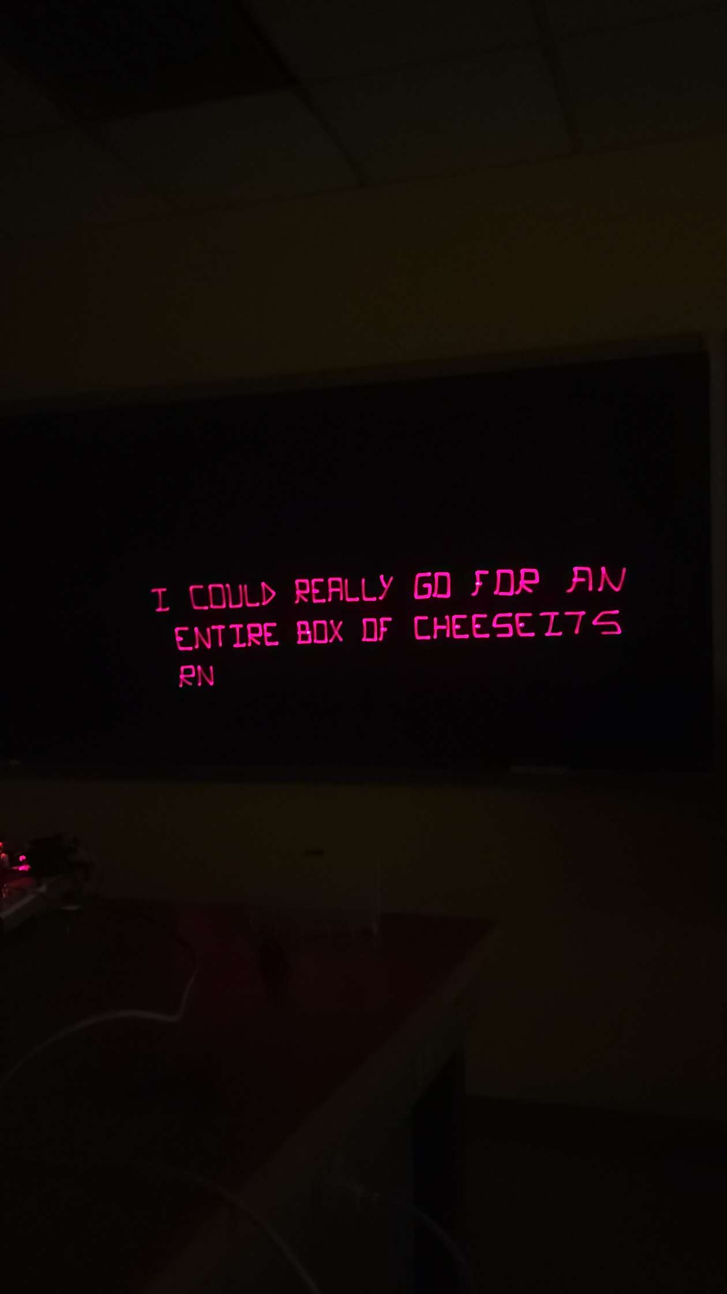
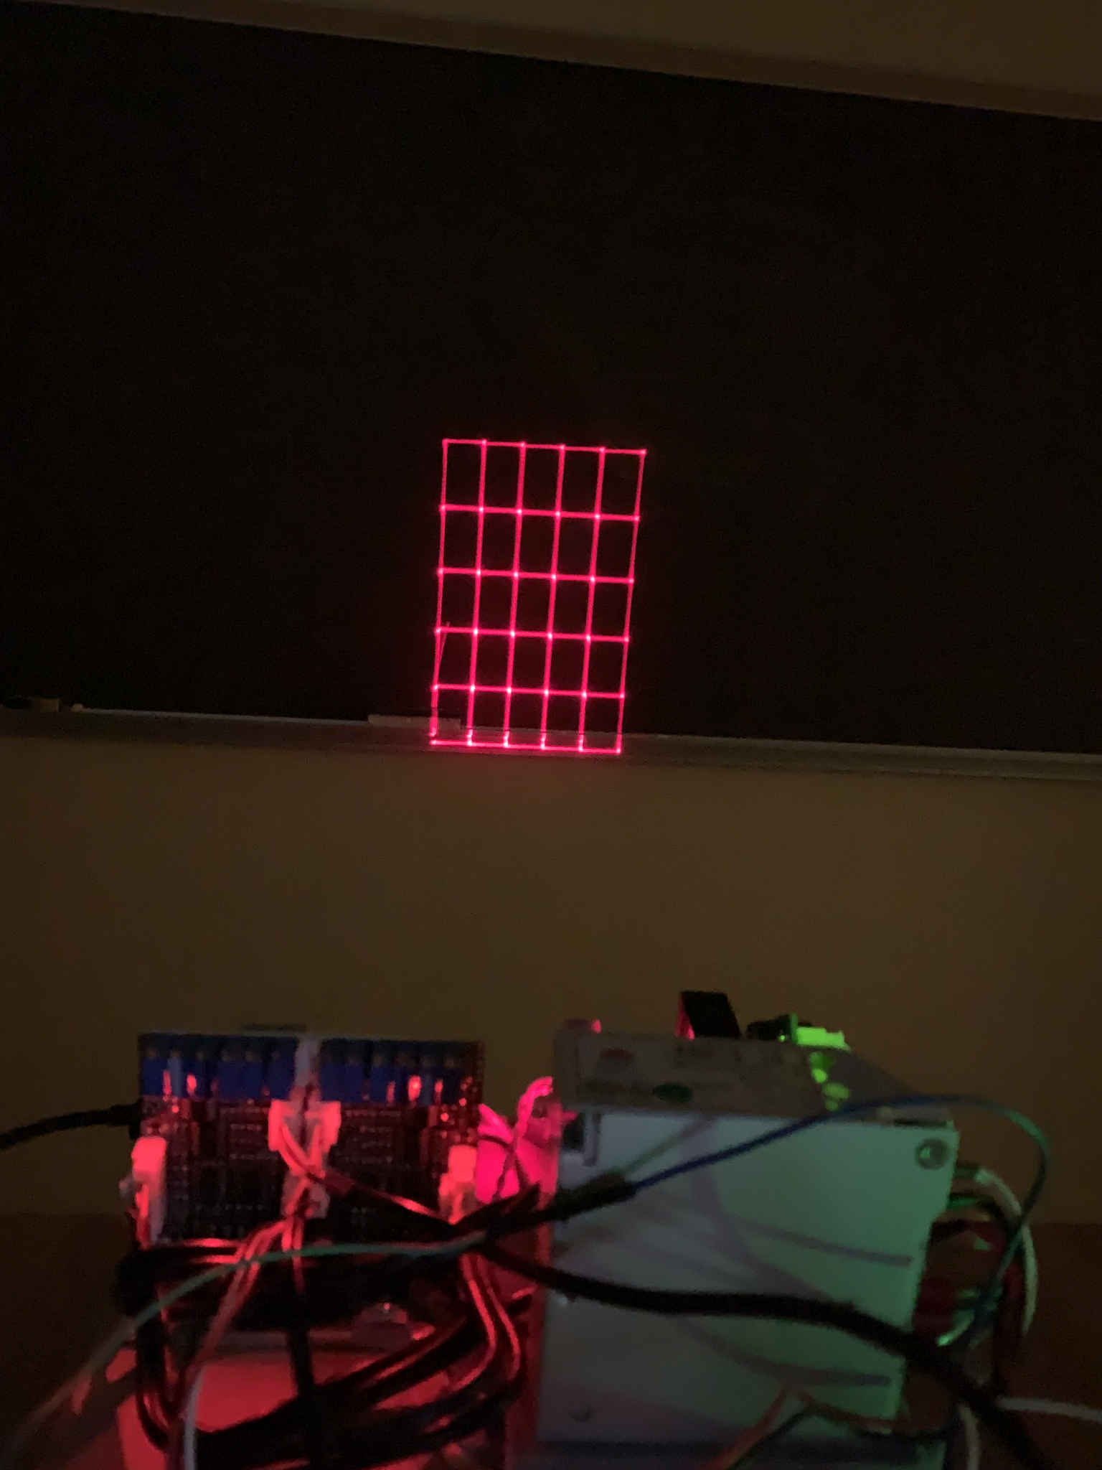
Summary of functional performance, and operational test results

Slide 22
Project Administration

Slide 23
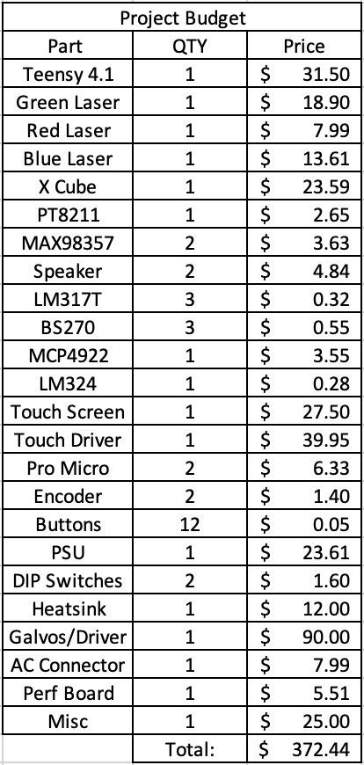
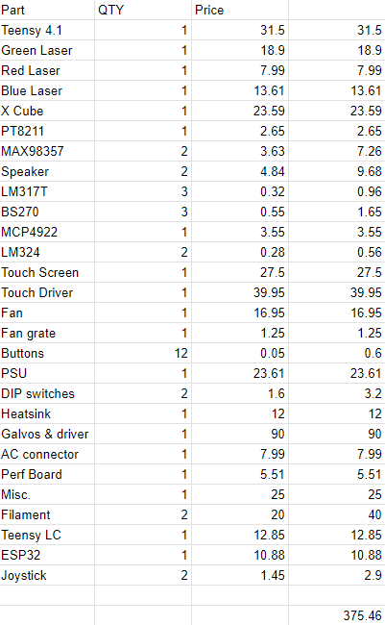
Budget
Early stage budget
Final stage budget

Slide 24
Ideal Schedule
Week | Tasks/Goals
1 (01/16/23-01/20/23) | Figure team schedule
2 (01/23/23-01/27/23) | Work on PDR slides
3 (01/30/23-02/03/23) | Present PDR slides
4 (02/06/23-02/10/23) | 2D motion control
5 (02/13/23-02/17/23) | Laser power control
6 (02/20/23-02/24/23) | Display multiple objects
Week | Tasks/Goals
7 (02/27/23-03/03/23) | Controllers
8 (03/06/23-03/10/23) | Code a library to display basic shapes
9 (03/13/23-03/17/23) | Code pong
10 (03/20/23-03/24/23) | Display Pong using library
11 (03/27/23-03/31/23) | Troubleshooting
12 (04/03/23-04/07/23) | Functioning Laser Projector
13 (04/10/23-04/14/23) | Expo Presentation

Slide 25
Actual Schedule
Week | Tasks/Goals
1 (01/16/23-01/20/23) | Figure team schedule
2 (01/23/23-01/27/23) | Work on PDR slides
3 (01/30/23-02/03/23) | Present PDR slides
4 (02/06/23-02/10/23) | 2D motion control
5 (02/13/23-02/17/23)
6 (02/20/23-02/24/23) | Multiple Colors RGB and Laser power control
7 (02/27/23-03/03/23) | Controllers Also, ILDA files are a goal now
8 (03/06/23-03/10/23) | Code a library to display basic shapes and ILDA files.
Week | Tasks/Goals
10 (03/20/23-03/24/23) | Physics Engine, Completely remake board from scratch, also 3D print a case
11 (03/27/23-03/31/23) | Physics Engine. Also, Bluetooth doesn’t work anymore, switched controllers to wired
12 (04/03/23-04/07/23) | LCD Display, Buttons and Screen, Get Controllers working wired
13 (04/10/23-04/14/23) | All The Games, integrate and control unit from lcd, EXPO

Slide 26
Personnel Time
Ian ~ 20hrs/week
Drew ~ 15 hrs/week
Adi ~ 15 hrs/ week
Dom ~ 20hrs/week

Slide 27
Status of Intellectual Property
Extensive Software library - Dominic
Schematics - Ian
CAD models - Ian

Slide 28
Conclusions

Slide 29
Overall Conclusions
Summary of meeting requirements
All of the stated technical design requirements and objectives were met with a functional multicolor laser projector that can project animations, shapes and pong with a few other games.
The main alteration was switching from one laser to three lasers that point into an X Cube.
Estimate the percentage completion in terms of
Functionality 80%
Performance 80%
Operation 90%
Customers need 100%

Slide 30
Overall Conclusions
Recommendations for future design/development including potential spin-off projects
Have a backup set of lasers on hand just in case.
Lessons Learned
Software
Arduino IDE is limited, use PlatformIO
Everything is an object, expandability is key

Slide 31
Demonstration

